Slide 1


Retracing the Siege of
Hong Kong Polytechnic University
David Calano
CS 895 - Web Archiving Forensics
Old Dominion University
October 31st, 2022
@lifefromalaptop
CS895 - Web Archiving Forensics
Fall 2022

Slide 2
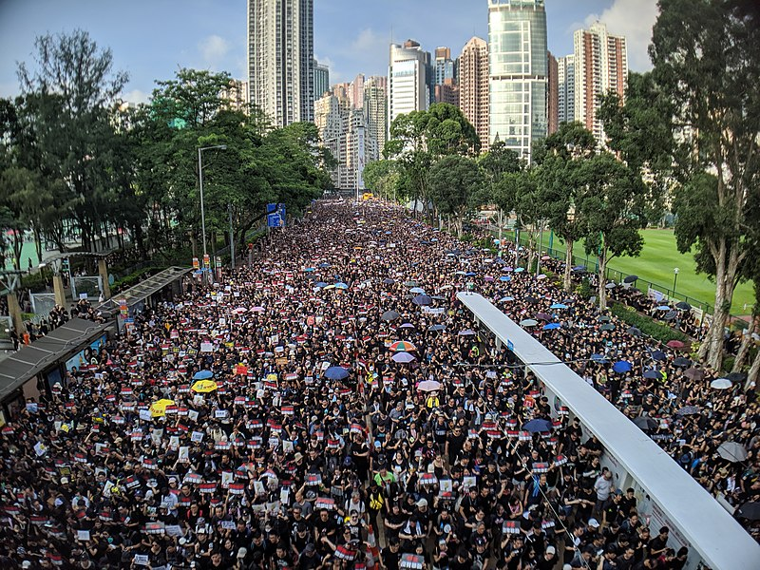
Hong Kong Protests Against Mainland Extradition
https://origins.osu.edu/article/hong-kong-protest-china-extradition-umbrella
@lifefromalaptop
CS895 - Web Archiving Forensics
Fall 2022

Slide 3
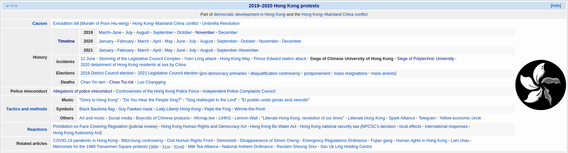
Over 600 Total Wiki Citations
https://en.wikipedia.org/wiki/Siege_of_the_Hong_Kong_Polytechnic_University
@lifefromalaptop
CS895 - Web Archiving Forensics
Fall 2022

Slide 4
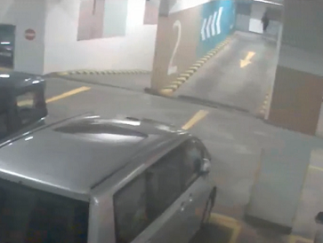
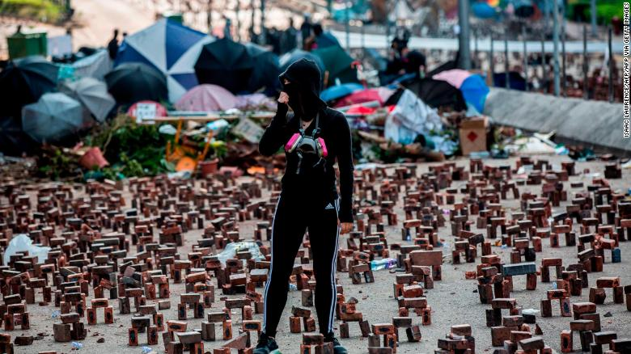
Renewed Fervor Over Death of Student Chow Tsz-Iok
https://web.archive.org/web/20191119022259/https://edition.cnn.com/2019/11/07/asia/hong-kong-protester-death-intl-hnk/index.html
https://web.archive.org/web/20191115170041/https://www.cnn.com/2019/11/15/asia/hong-kong-protest-university-fortress-intl-hnk/
@lifefromalaptop
CS895 - Web Archiving Forensics
Fall 2022

Slide 5
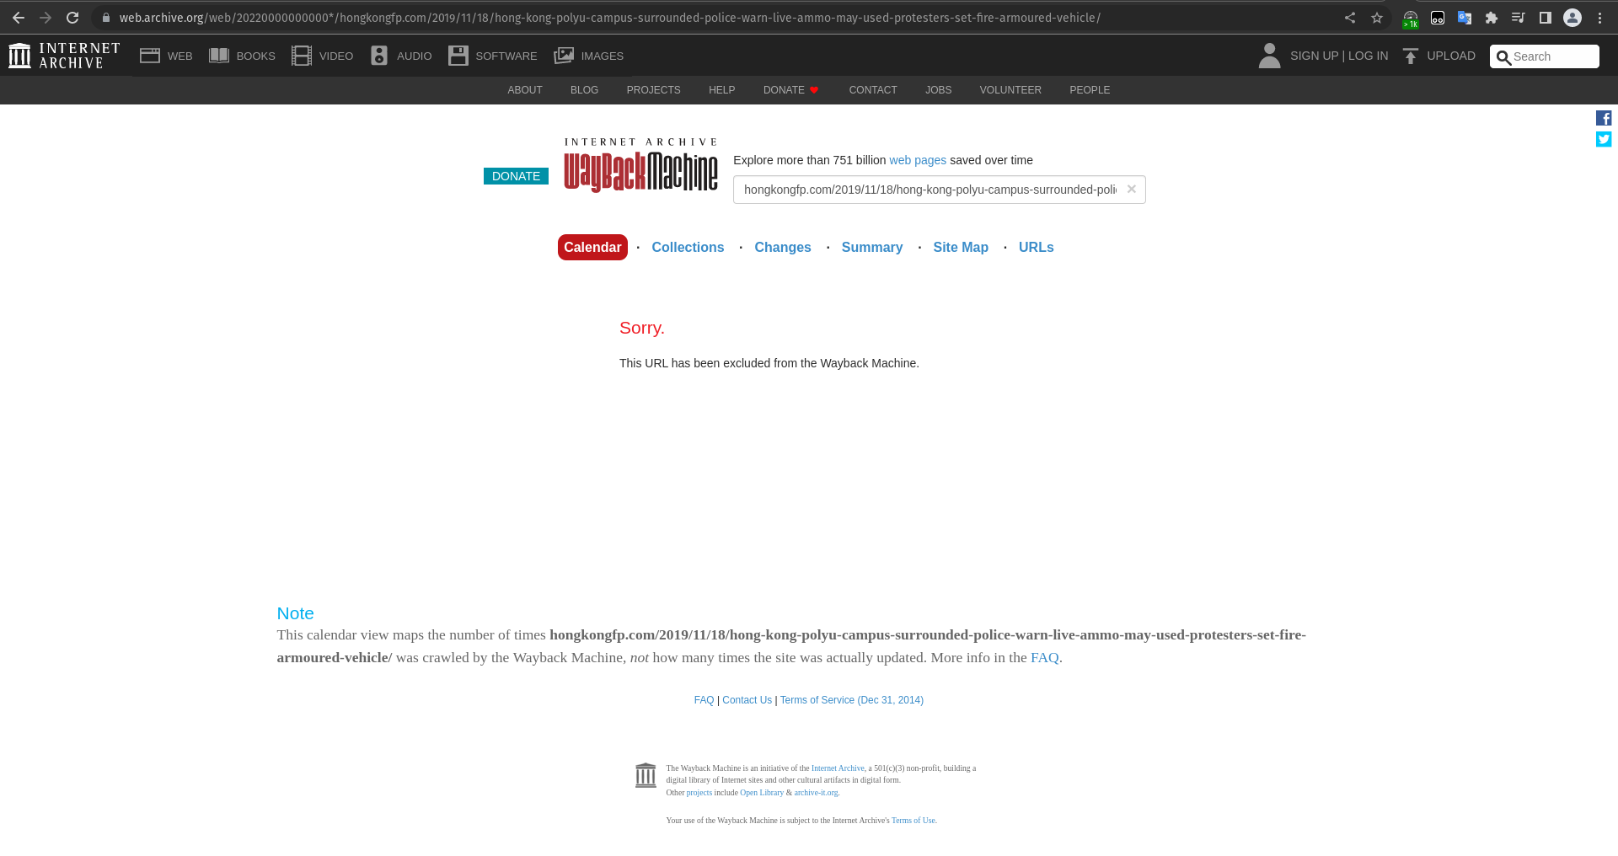
Popularity Is No Guarantee of Safety
https://web.archive.org/web/20220000000000*/https://hongkongfp.com/2019/11/18/hong-kong-polyu-campus-surrounded-police-warn-live-ammo-may-used-protesters-set-fire-armoured-vehicle/
@lifefromalaptop
CS895 - Web Archiving Forensics
Fall 2022

Slide 6
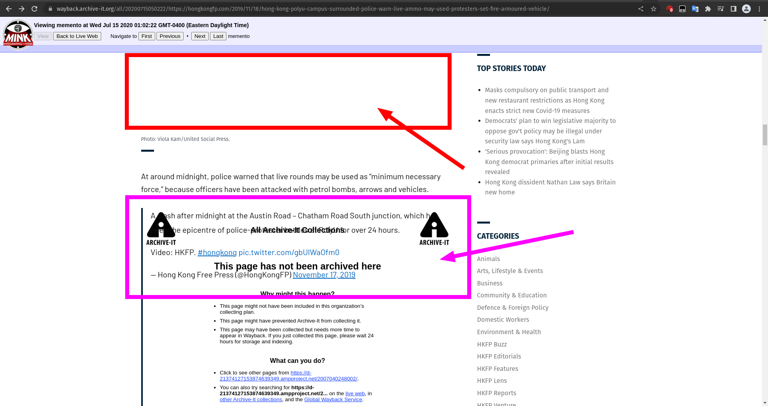
Is Quantity Worth Quality?
Missing Images
Overlapping Content
+
Missing Embeds
https://wayback.archive-it.org/all/20200715050222/https://hongkongfp.com/2019/11/18/hong-kong-polyu-campus-surrounded-police-warn-live-ammo-may-used-protesters-set-fire-armoured-vehicle/
@lifefromalaptop
CS895 - Web Archiving Forensics
Fall 2022

Slide 7
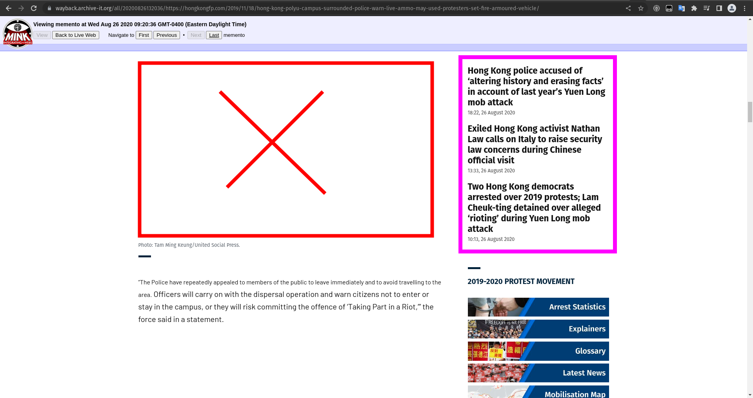
What of Future Fortunes?
https://wayback.archive-it.org/all/20200826132036/https://hongkongfp.com/2019/11/18/hong-kong-polyu-campus-surrounded-police-warn-live-ammo-may-used-protesters-set-fire-armoured-vehicle/
@lifefromalaptop
CS895 - Web Archiving Forensics
Fall 2022

Slide 8
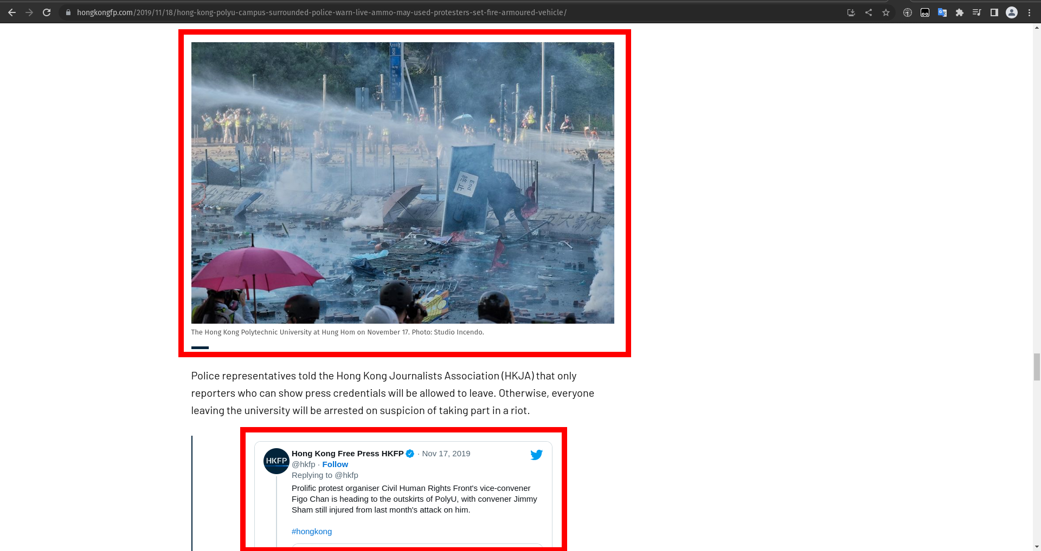
Far Cry From Home
https://hongkongfp.com/2019/11/18/hong-kong-polyu-campus-surrounded-police-warn-live-ammo-may-used-protesters-set-fire-armoured-vehicle/
@lifefromalaptop
CS895 - Web Archiving Forensics
Fall 2022

Slide 9
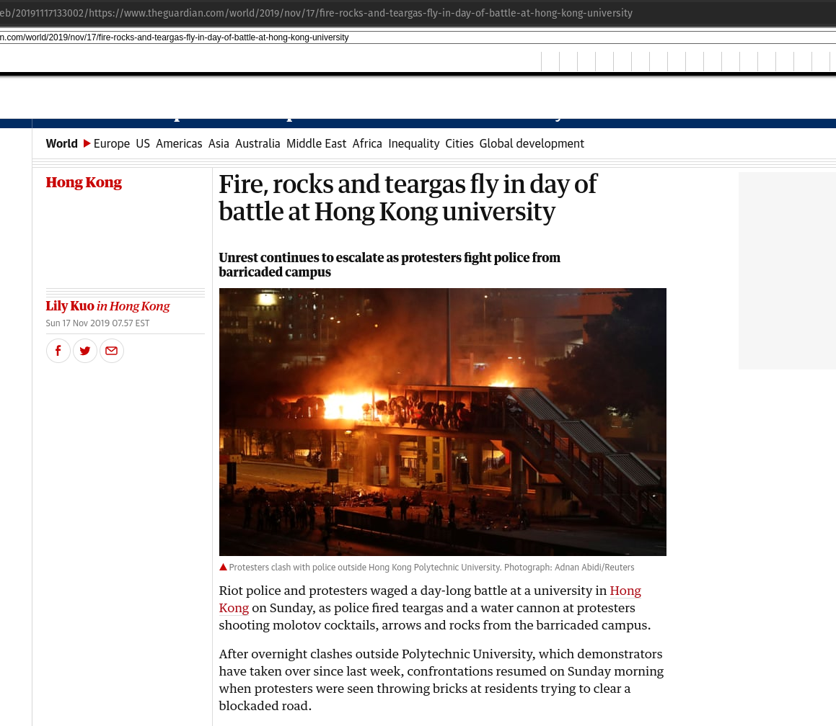
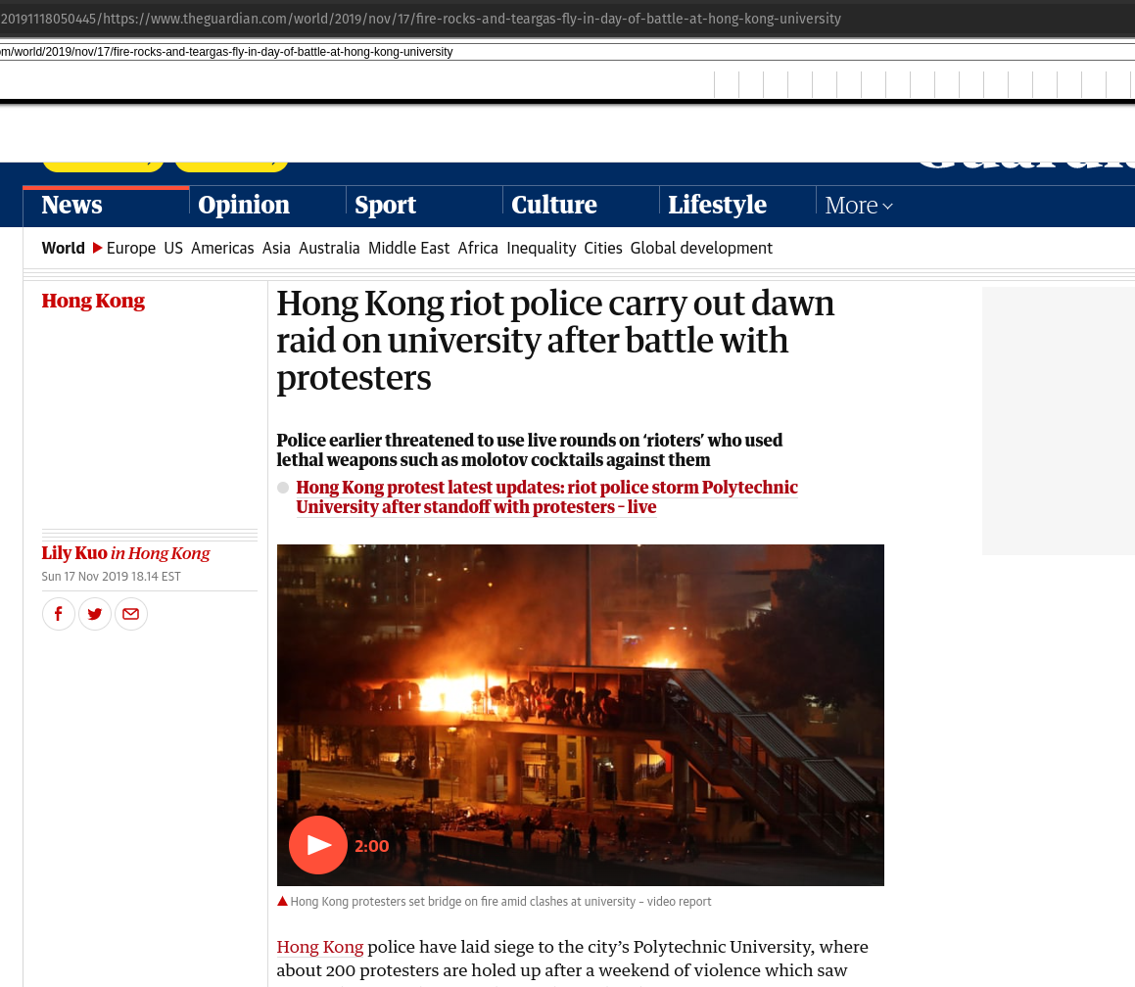
Same Story, Different Day
https://web.archive.org/web/20191117133002/https://www.theguardian.com/world/2019/nov/17/fire-rocks-and-teargas-fly-in-day-of-battle-at-hong-kong-university
https://web.archive.org/web/20191118050445/https://www.theguardian.com/world/2019/nov/17/fire-rocks-and-teargas-fly-in-day-of-battle-at-hong-kong-university
@lifefromalaptop
CS895 - Web Archiving Forensics
Fall 2022

Slide 10
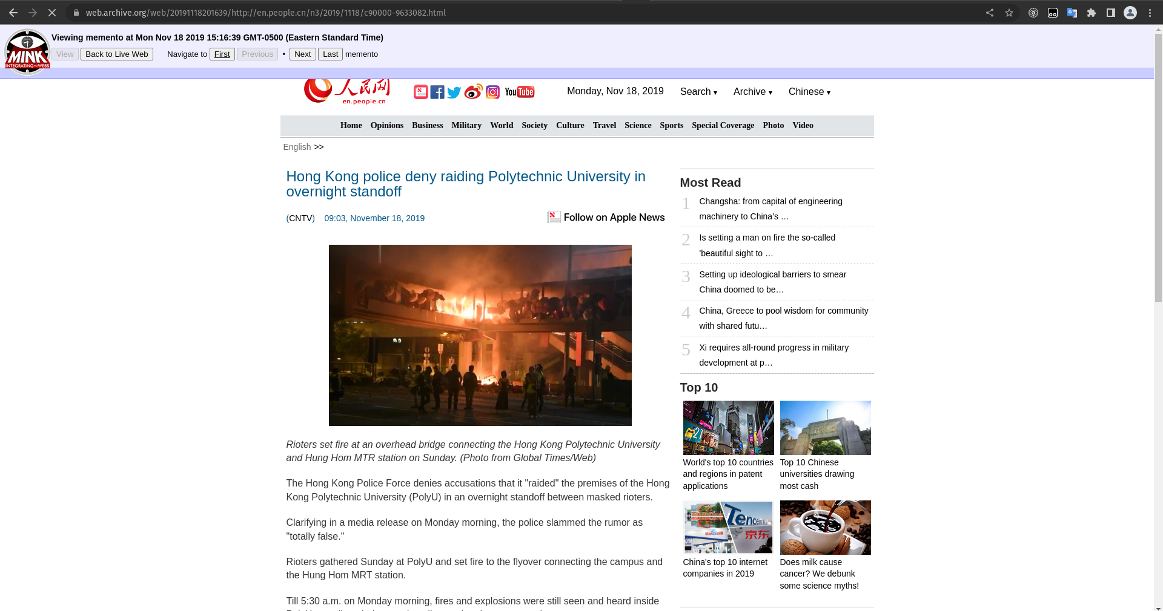
A Conflict of Narrative
@lifefromalaptop
CS895 - Web Archiving Forensics
Fall 2022

Slide 11
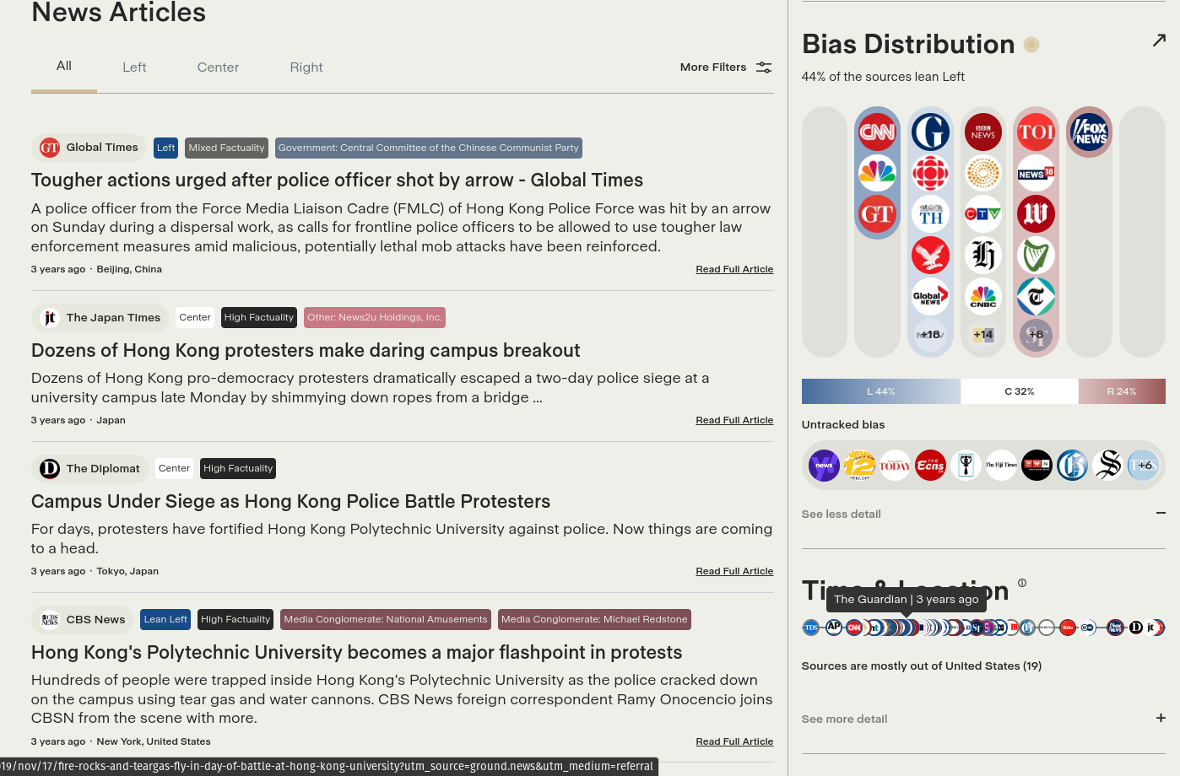
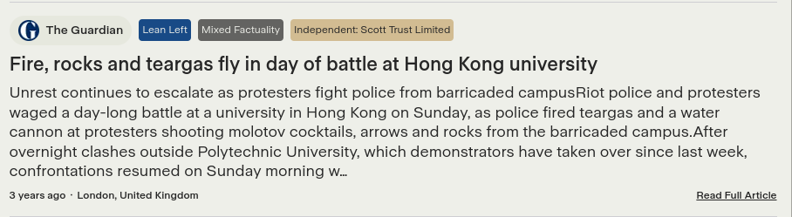
Mirror, Mirror, Which Is Fairest?
https://ground.news/article/9e943cc9-c20f-4172-9267-c33d5221a3c8
@lifefromalaptop
CS895 - Web Archiving Forensics
Fall 2022

Slide 12
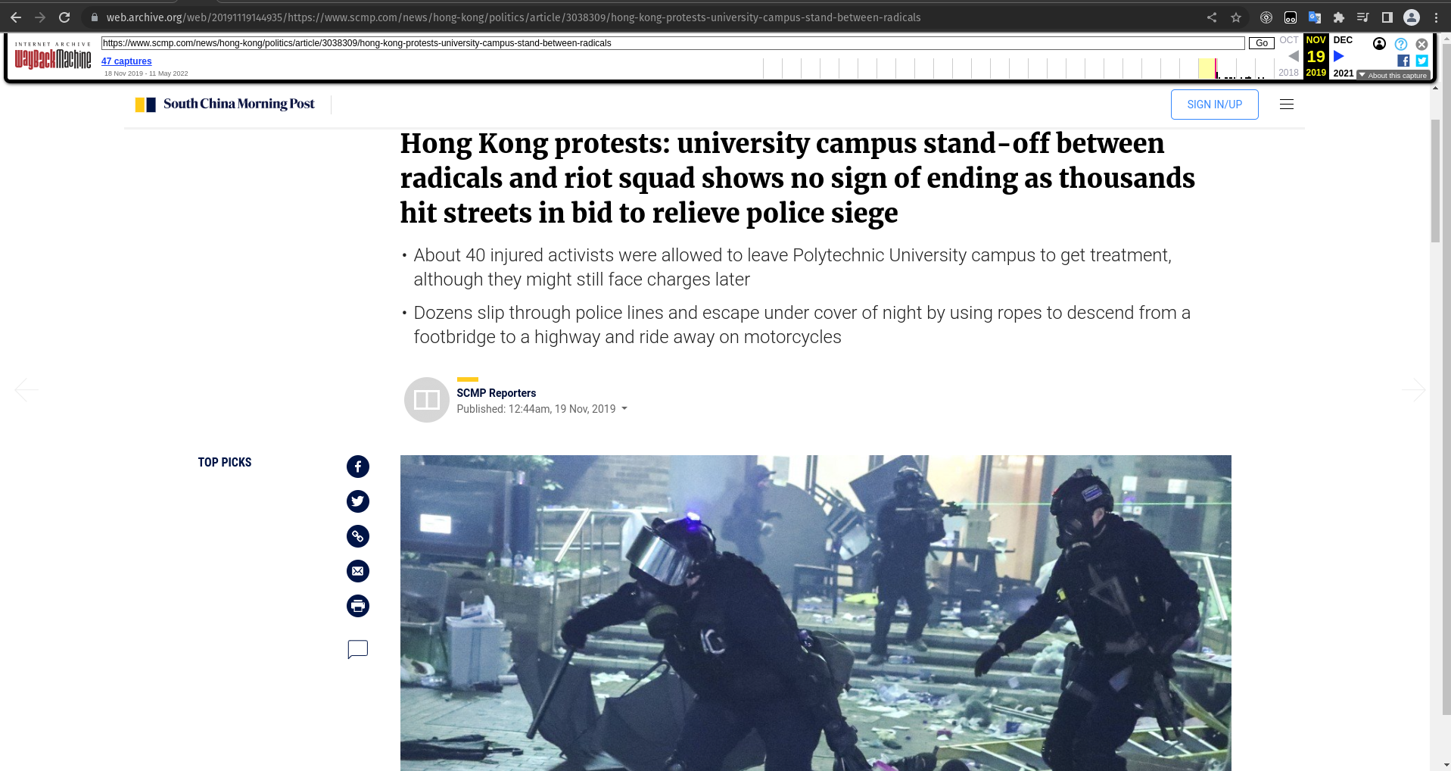
Escalation, Evasion, Escape of Truth
https://web.archive.org/web/20191119144935/https://www.scmp.com/news/hong-kong/politics/article/3038309/hong-kong-protests-university-campus-stand-between-radicals
@lifefromalaptop
CS895 - Web Archiving Forensics
Fall 2022

Slide 13
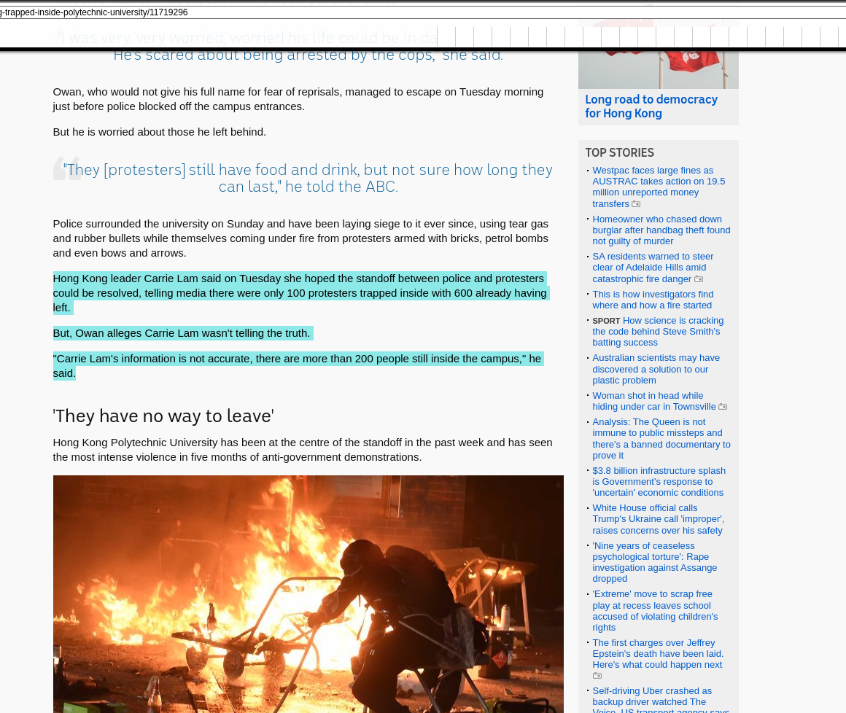
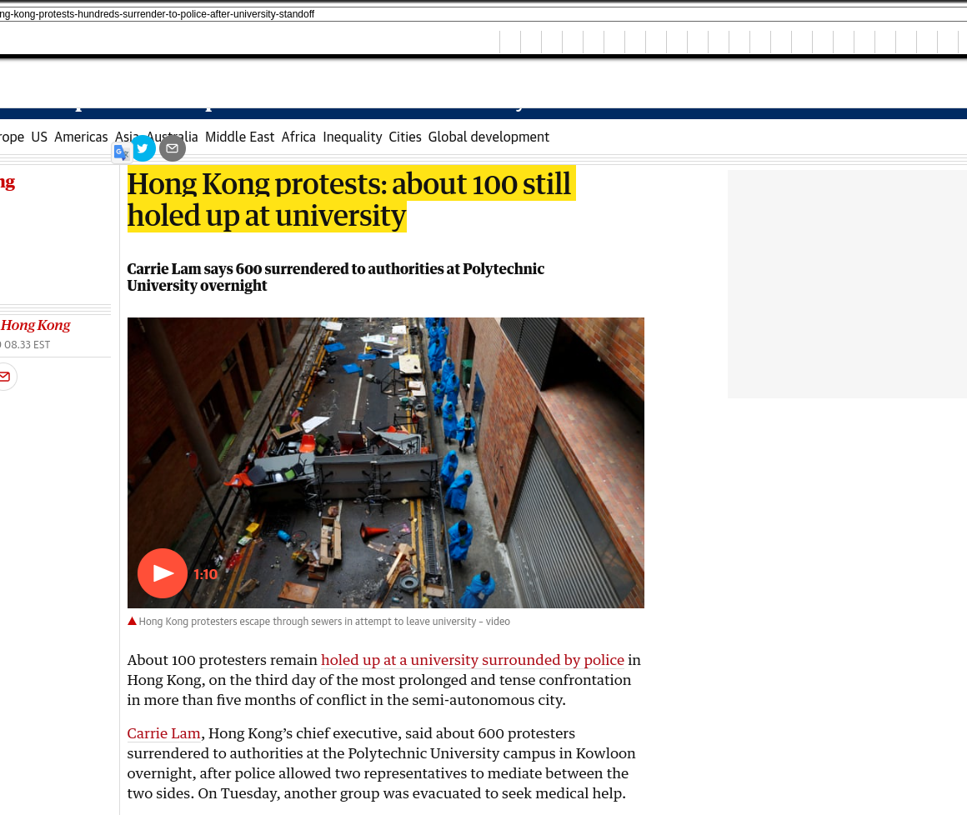
Discrepancy of Ground Truth
https://web.archive.org/web/20191119144210/https://www.theguardian.com/world/2019/nov/19/hong-kong-protests-hundreds-surrender-to-police-after-university-standoff
https://web.archive.org/web/20191120020419/https://www.abc.net.au/news/2019-11-19/hong-kong-trapped-inside-polytechnic-university/11719296
@lifefromalaptop
CS895 - Web Archiving Forensics
Fall 2022

Slide 14
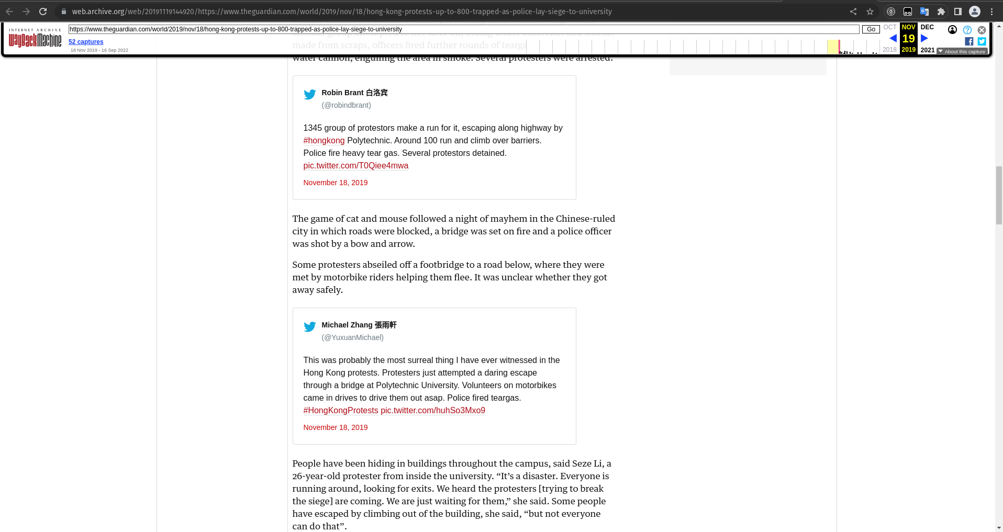
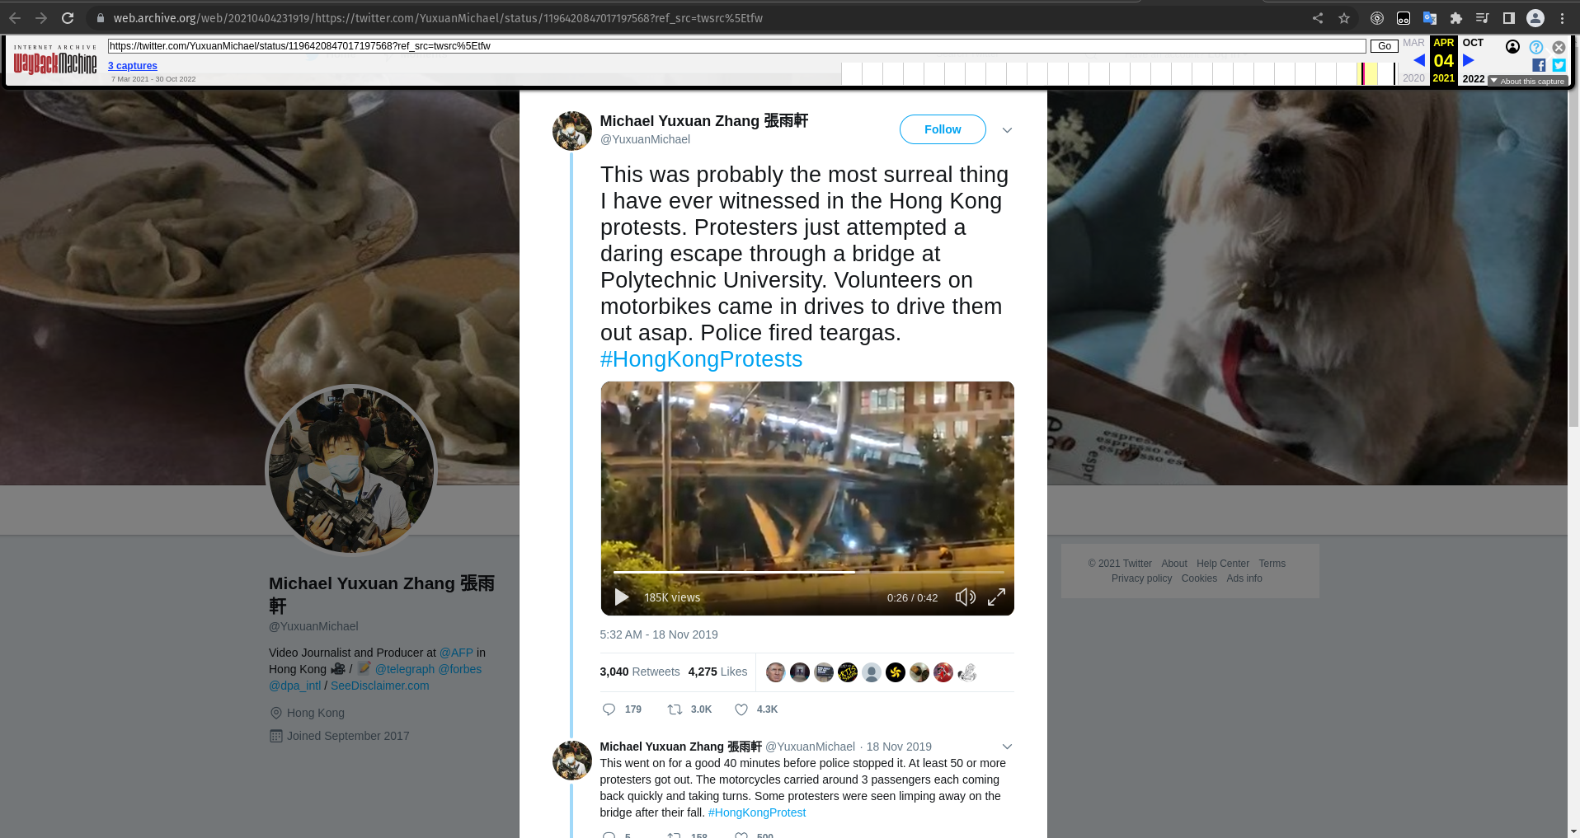
When It Works, It’s Wonderful!
https://web.archive.org/web/20191119144920/https://www.theguardian.com/world/2019/nov/18/hong-kong-protests-up-to-800-trapped-as-police-lay-siege-to-university
https://web.archive.org/web/20210404231919/https://twitter.com/YuxuanMichael/status/1196420847017197568?ref_src=twsrc%5Etfw
@lifefromalaptop
CS895 - Web Archiving Forensics
Fall 2022

Slide 15
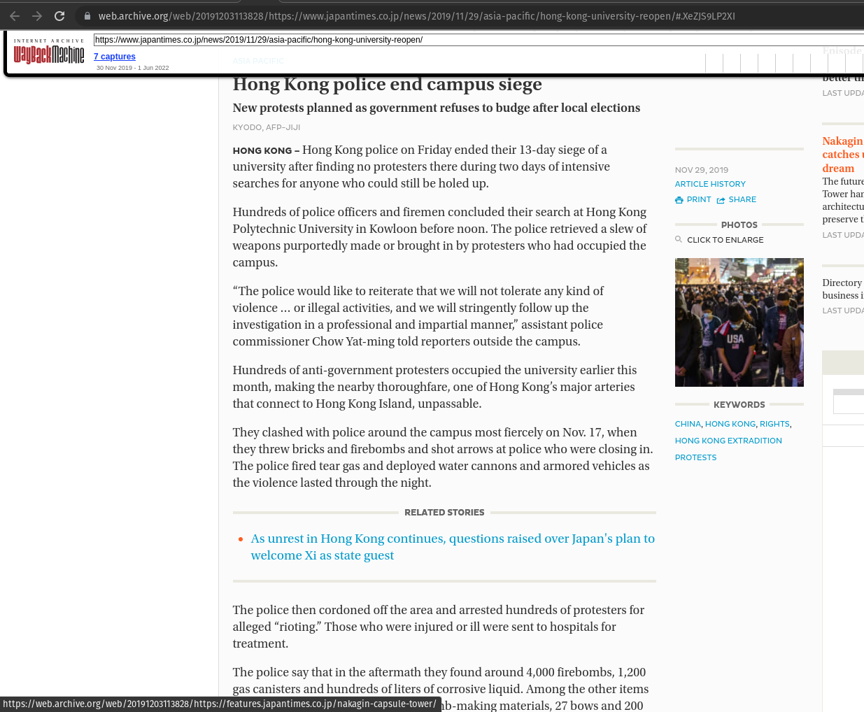
Campus Siege Declared Over On November 29, after 13 days
https://web.archive.org/web/20191203113828/https://www.japantimes.co.jp/news/2019/11/29/asia-pacific/hong-kong-university-reopen/#.XeZJS9LP2XI
@lifefromalaptop
CS895 - Web Archiving Forensics
Fall 2022

Slide 16
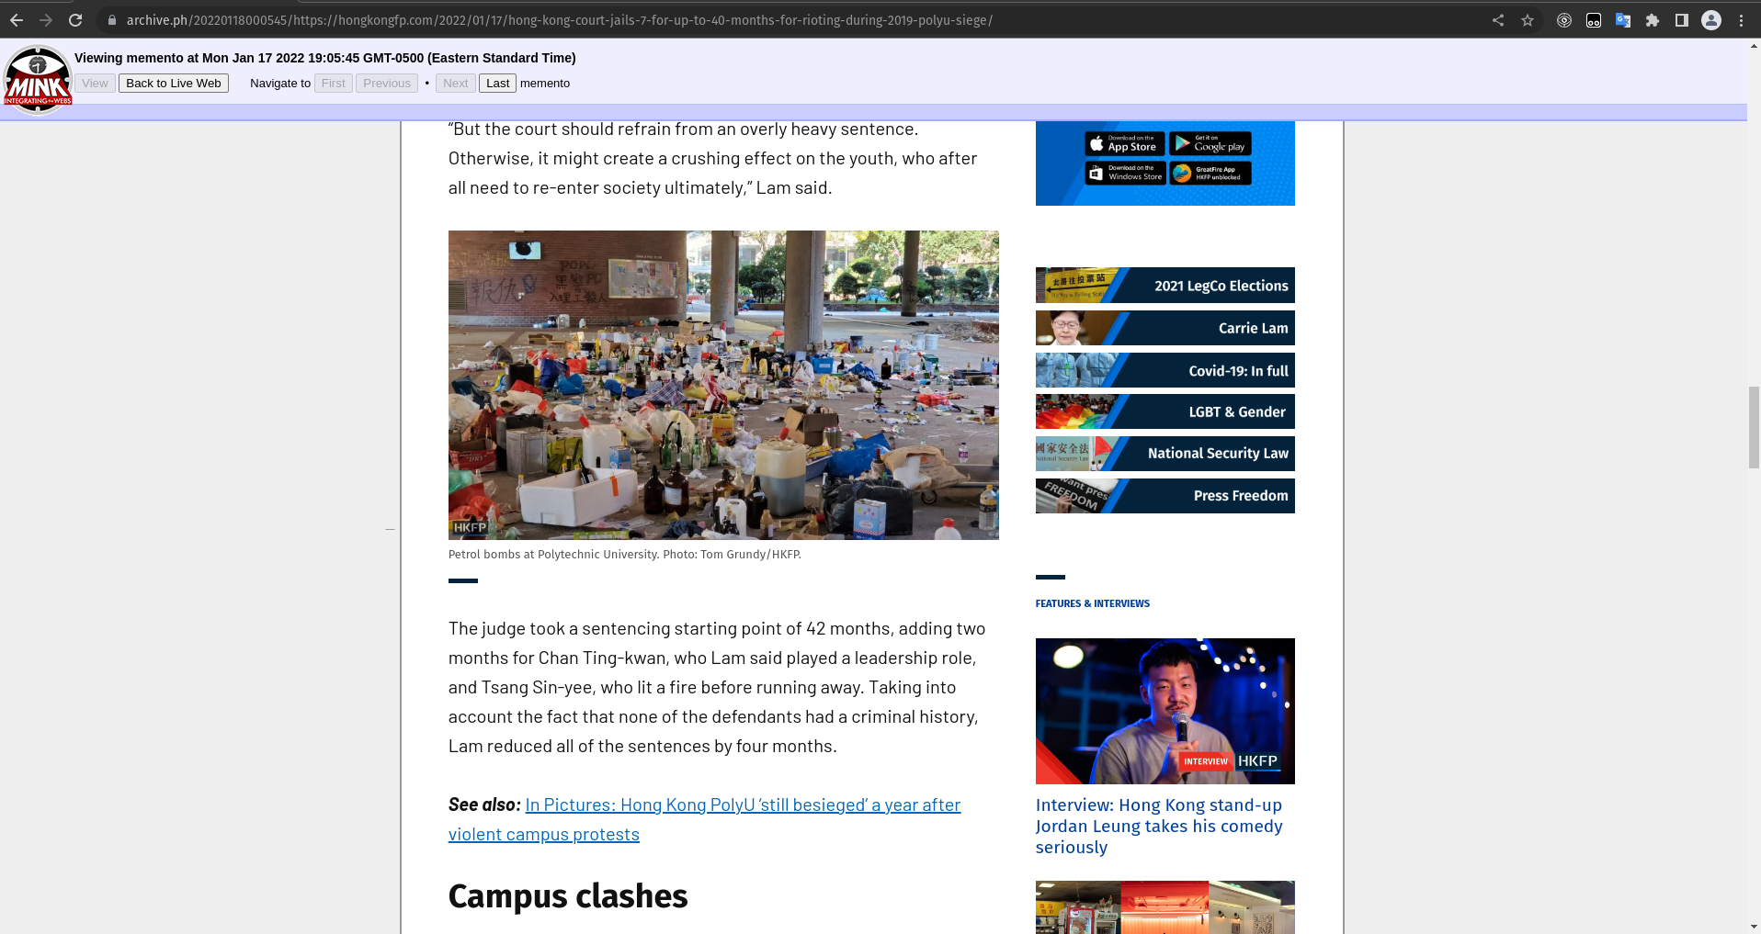
7 Protestors Jailed
https://archive.ph/20220118000545/https://hongkongfp.com/2022/01/17/hong-kong-court-jails-7-for-up-to-40-months-for-rioting-during-2019-polyu-siege/
@lifefromalaptop
CS895 - Web Archiving Forensics
Fall 2022

Slide 17
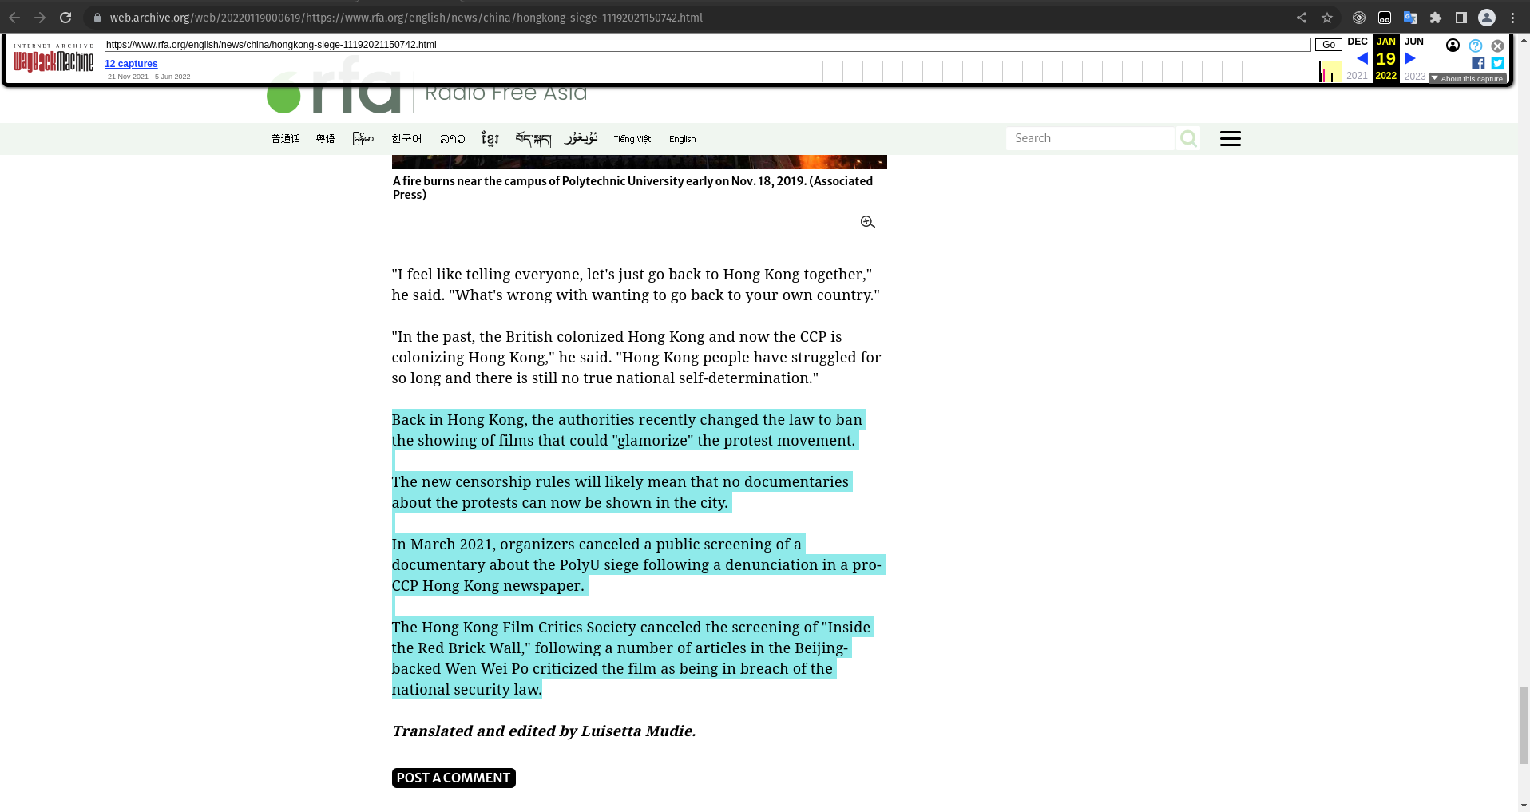
Ghosts of Archives Past
https://web.archive.org/web/20220119000619/https://www.rfa.org/english/news/china/hongkong-siege-11192021150742.html
@lifefromalaptop
CS895 - Web Archiving Forensics
Fall 2022

Slide 18
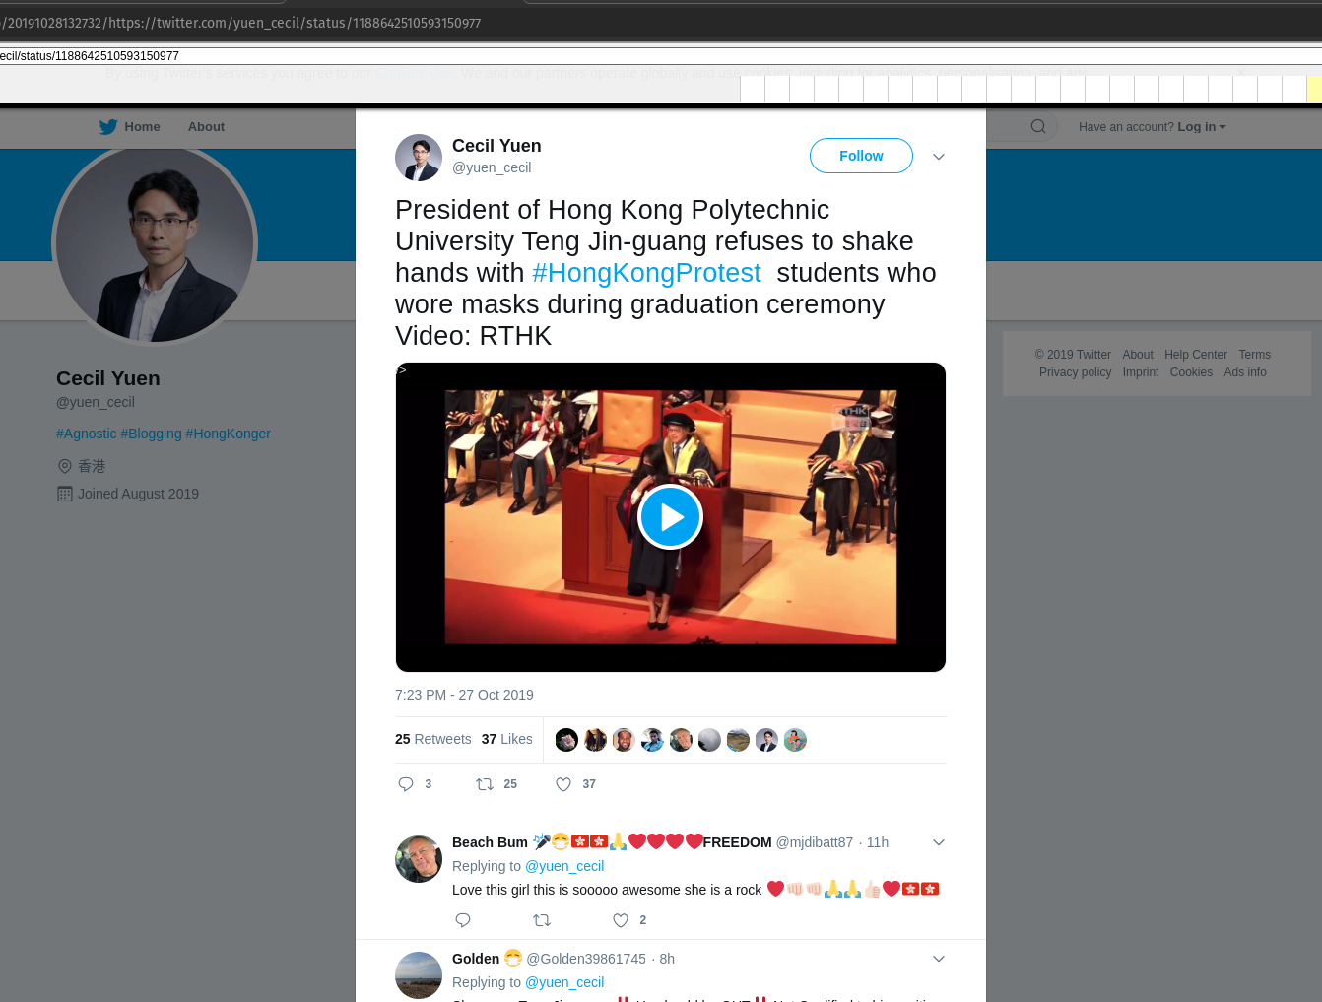
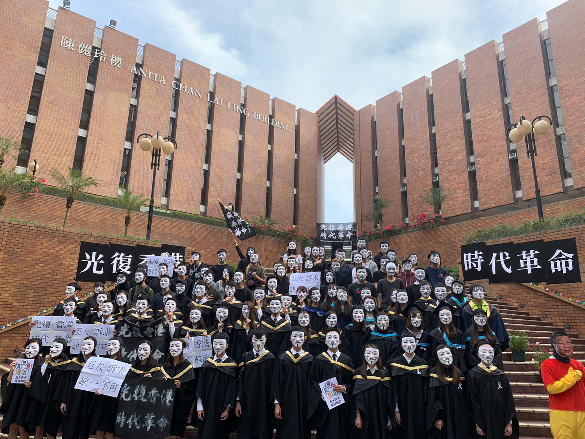
They Didn’t Forget, They Haven’t Forgave
https://web.archive.org/web/20191028132732/https://twitter.com/yuen_cecil/status/1188642510593150977
https://web.archive.org/web/20191112131845/https://i.redd.it/jmi3b8vmomv31.png
@lifefromalaptop
CS895 - Web Archiving Forensics
Fall 2022

Slide 19
Why is archiving important?
What we might believe to be enduring may turn out to be fragile
Necessity of distributed information
Improvements to information infrastructure
Necessity of open communication and transparency
@lifefromalaptop
CS895 - Web Archiving Forensics
Fall 2022

